Slide 1
Early Dementia Identification With ML
BMI734
Purushottam Panta
PhD student, Department of CS

Slide 2
Background
The proposed machine learning model comparison helps clinical professionals to identify the better predicting models
Which helps them identify the potential candidate to intervene and continue medication
If the medical intervene can happen in the early stage of the dementia, that can help alleviate symptoms and likely slow down the Alzheimer disease. So, predicting the subjects that potentially develop the disease plays a crucial role.

Slide 3
Introductions
Identify the subjects that they potentially develop the Dementia based on the features given on OSAIS dataset (with MRI)
Input Data
Data cleanup and Preprocessing
Also, include MMSE score in the data and test with SVM and LSTM
ML algorithms:
Random Forest (RF)
Support Vector Machine (SVM)
LSTM

Slide 4
Dataset
Longitudinal MRI of 150 subjects aged between (60 and 96)
72 : Nondemented
64 : Demented
14 : Converted from Nondemented to Demented throughout the study => Converted category
Only right-handed subjects were selected
Data from Open Access Series of Imaging Studies (OASIS)

Slide 5
Feature Selection
Mini Mental State Examination (MMSE):
Examination performed on various mental puzzle and questions, and score given based on answer.
EDUC: Number of year of education
Socioeconomic Status (SES)
Clinic Dementia Rating (CDR):
Ratings are assigned on a 0–5 point scale:
0 = absent; 0.5 = questionable; 1= present, but mild;
2 = moderate; 3 = severe; 4 = profound; 5 = terminal

Slide 6
Feature Selection Contd.
Estimated Total Intracranial Volume (eTIV):
Estimated total intracranial Volume.
Normalized Whole Brain Volume (nWBV):
Expressed as a percent of all voxels. Normalized whole brain volume.
Atlas Scaling Factor (ASF):
Atlas-based head size normalization technique to Measure the standardized total intracranial volume for comparison, classification and prediction.

Slide 7
Measure accuracy - AUC
 |  | ACTUAL
 |  | Positive | Negative
PREDICTED | Positive | True Positive | False Positive
 | Negative | False Negative | True Negative
True positives: data points labelled as positive that are actually positive
False positives: data points labelled as positive that are actually negative
True negatives: data points labelled as negative that are actually negative
False negatives: data points labelled as negative that are actually positive

Slide 8

Precision and Accuracy
$$Precision=\frac{TP}{TP+FP} Recall=\frac{TP}{TP+FN}$$
$$Accuracy=\frac{TP+TN}{TP+TN+FP+FN}$$
$$F1 Score=\frac{TP}{TP+1/2(FP+FN)}$$

Slide 9

Softmax and Cross-Entropy in LSTM
$$Softmax\left(Zi\right)= \frac{exp⁡(Zi)}{\sum_{j}{exp⁡(Zj)}}$$
$$Cross Entropy Loss=−\sum_{i}^{C}{Ti ×log⁡(f\left(s\right)i)}$$
S
Softmax(Zi)
Cross Entropy Loss
S_{i}

Slide 10
Libraries being used
from sklearn.model_selection import train_test_split
from sklearn import preprocessing
from sklearn.preprocessing import MinMaxScaler
from sklearn.model_selection import cross_val_score
Import numpy as np
Import pandas as pd
Import seaborn as sns
Import matplotlib.pyplot as plt

Slide 11
Data preprocessing
# Imputation of the input datasets
Y = df['Group'].values # The model "target variable“
# We are going to take the following features:
X = df[['M/F', 'Age', 'EDUC', 'SES', 'MMSE', 'eTIV', 'nWBV', 'ASF’]]
# Scaling the features
scaler = MinMaxScaler().fit(X_trainval)
X_train_scaled = scaler.transform(X_trainval)
X_test_scaled = scaler.transform(X_test)

Slide 12
Random Forest
Algorithm1: Random Forest
For a tree T_{i} in range R, and features in F_{i}, and depth D_{i}:
Build a Random Forest Model
Compute cross validation score
Find the best cross-validation score for more accuracy.
Pick the random forest model with the best score.
Fit the model and predict.
Where, T_{i} is i^{th} tree in Range R = (5, 15, 20). F_{i} is the max number of features.

Slide 13
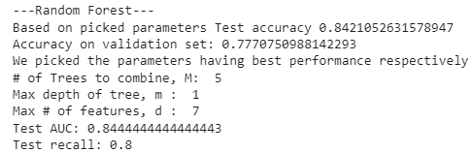
Random Forest

Slide 14
Support Vector Machine (SVM)
Gamma parameter => how far the influence of a single training example reaches.
High gamma value => only the closest points to the decision boundary will carry the weight.
c parameter checked in: 0.001 to 1000 in 10 folds

Slide 15
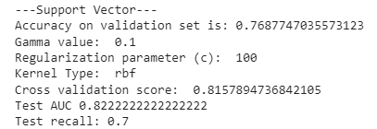
Support Vector Machine (SVM)

Slide 16
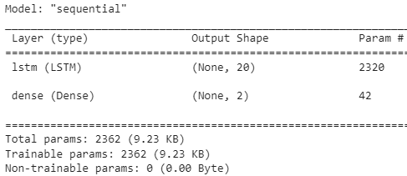
Long Short-Term Memory (LSTM)

Slide 17
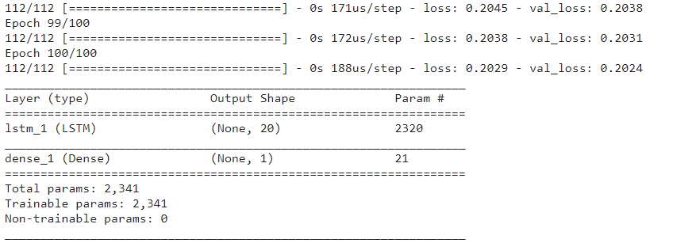
LSTM Contd.

Slide 18
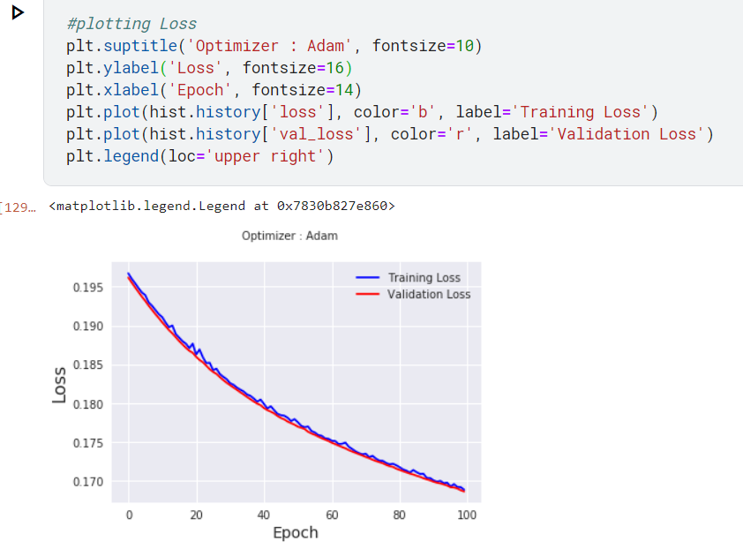
Plotting the lost in LSTM

Slide 19
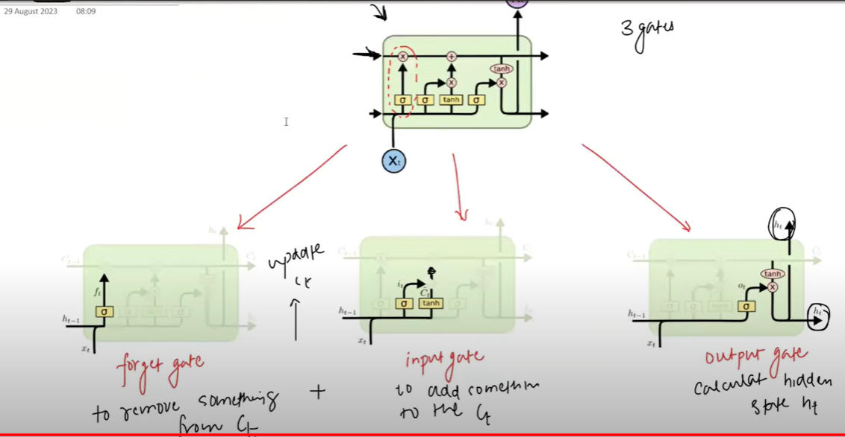
LSTM Cell

Slide 20
Summary
ML System | AUC | Recall
Random Forest (RF) | 0.844 | 0.8
Support Vector Machine (SVM) | 0.82 | 0.7
Long Short-term Memory (LSTM) | 0.845 | Need to calculate as future work

Slide 21
Future direction
May include up more features if available in other resources file.
Transformer models can also be implemented and examine the performance.
There are some pre-trained models in huggingface which most likely give move accuracy.

Slide 22
Suggestion / Questions
Thank you!

